Slide 1
Iterative versus Parallel Processing for Human Computation

Slide 2
Brainstorming
Our company sells headphones. There are many types and styles available. They are useful in different circumstances. Our site helps users assess their needs and get the pair of headphones that is right for them.
Please suggest 5 new company names for this company.
Notes:
First play video by Hanna and Mythili
First everyone should create 5 names on their own.
Draw a line underneath.
Next pass the paper to your right. Read what the other person wrote. Create 5 more ideas.
Draw a line underneath.
Next, discuss the ideas at your table. Create your 5 best ideas.

Slide 3
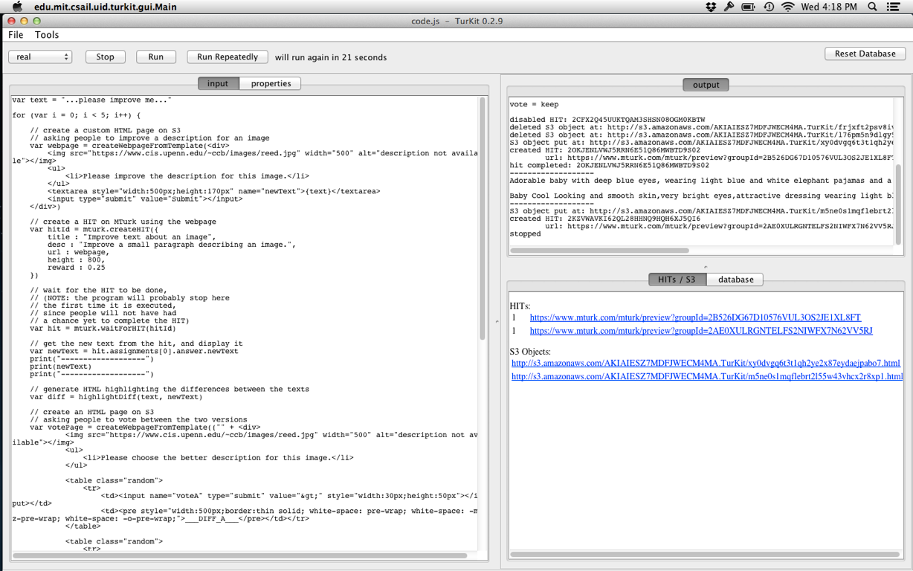
TurKit in action
Notes:
ccb - todo - show off example of TurKit running

Slide 4
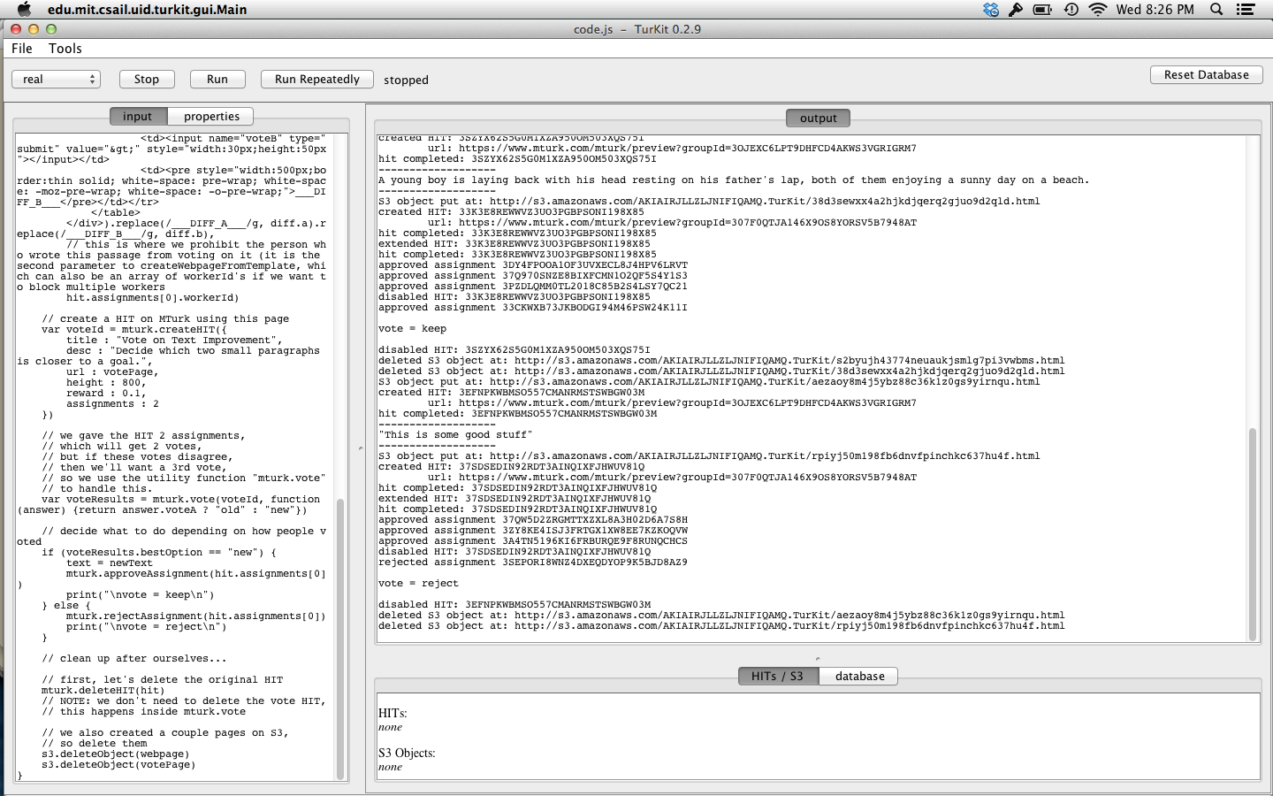
TurKit in action
Notes:
ccb - todo - show off example of TurKit running

Slide 5
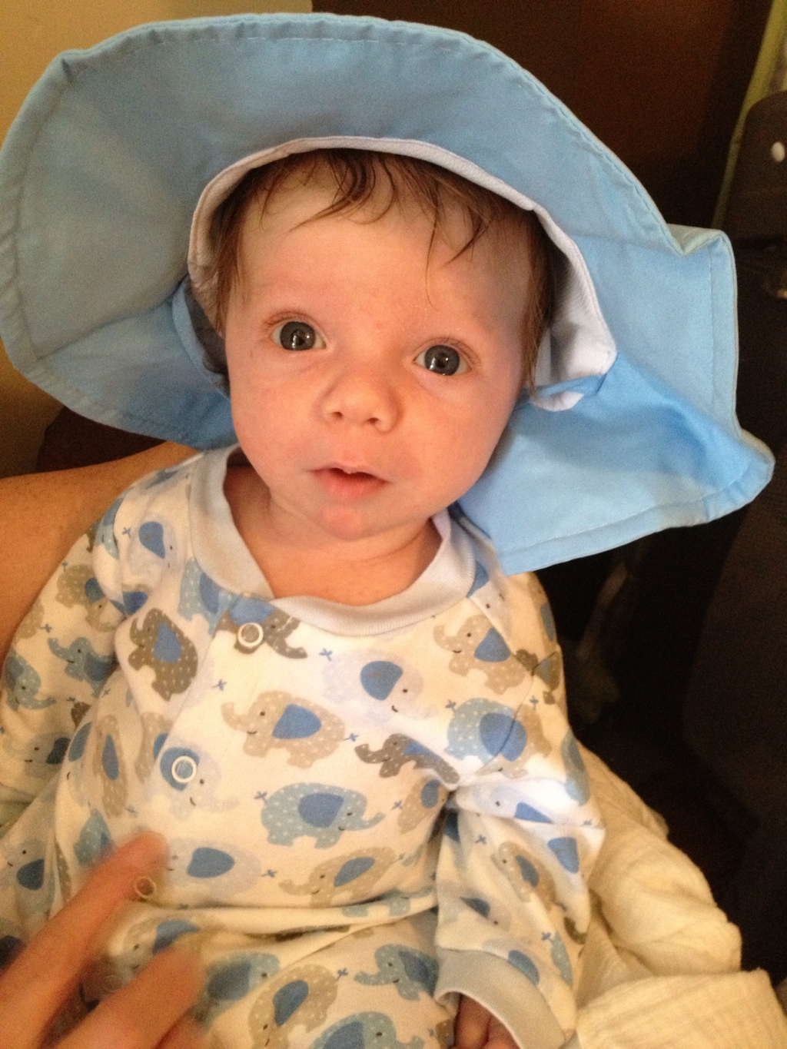
Adorable baby with deep blue eyes, wearing light blue and white elephant pajamas and a floppy blue hat.
Baby Cool Looking and smooth skin,very bright eyes,attractive dressing wearing light blue and white elephant pajamas and a floppy blue hat.Overall impression very sweet and also funny.

Slide 6
Father and son on a sandy beach.
Super cute kid lounges on a sandy beach with his father.
A father caught in a moment of ease with his young son, enjoying the natural vibes of the water and sand on a sunny day at the beach.
A young boy is laying back with his head resting on his father's lap, both of them enjoying a sunny day on a beach.
This is some good weed

Slide 7
What are the basic units of collecting work?
Human computation is a new field
Writing algorithms that involve people as function calls is relatively unexplored
How can we characterize the types of work that we can do, or the processes that yield the best results?

Slide 8
Iterative vs Parallel Processing
Basic distinction in the workflow
Should crowd workers do tasks independently in parallel?
Or should they work together in an iterative fashion and build off of each others’ work?

Slide 9
Tradeoffs
Iterative process shows each worker the results from previous workers
Must collect contributions serially
Parallel process asks each worker to solve a problem alone
No workers depend on the results of other workers, and so can be parallelized

Slide 10
Wikipedia vs Threadless
Iterative process: One person starts an article, and then other people iteratively improve it by looking at what people did before them and adding information, correcting grammar, creating a consistent style, etc.
Parallel process: T-shirts are created in parallel. People submit ideas independently, and then others vote to determine the best ideas that will be printed.

Slide 11
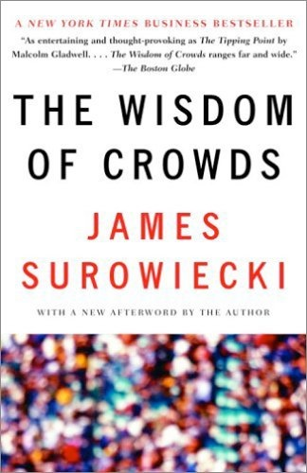
Wisdom of crowds
Requirements for a crowds to be wise:
Diversity of opinion
Independence
Decentralization
Aggregation

Slide 12
Wisdom of crowds: Independence
Surowiecki argues that aggregating answers from a decentralized, disorganized group of people all thinking independently yields more accurate answers than from individuals
Individual errors need to be uniformly distributed, and so individual judgments must be made independently

Slide 13
Does this hold empirically on MTurk?
Greg Little, Lydia Chilton, Max Goldman, and Rob Miller verify it through a set of experiments
Exploring tradeoffs between iterative vs parallel processing in writing, transcription, and brainstorming

Slide 14
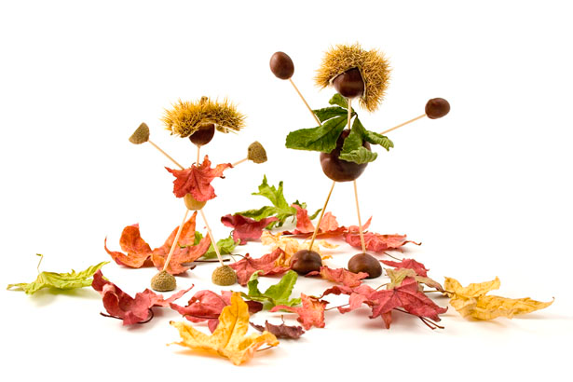
Writing
Notes:
This image shows an art project of people made out of nuts. They look like they are dancing in autumn leaves.
Creative mind must to do the art.
Male and female nuts are dancing with leaves flowers.
They are super match.

Slide 15
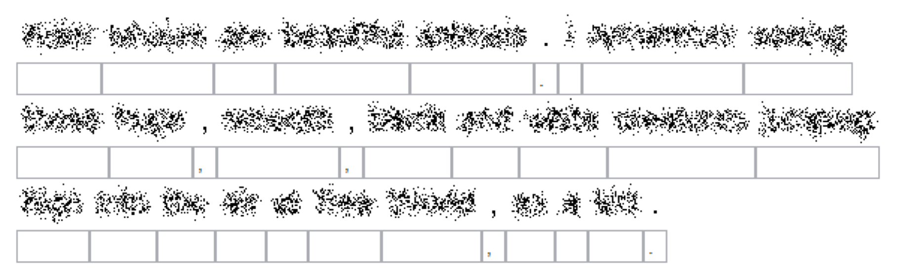
Transcription

Slide 16
Brainstorming
Our company sells headphones. There are many types and styles available. They are useful in different circumstances. Our site helps users assess their needs and get the pair of headphones that is right for them.
Please suggest 5 new company names for this company.

Slide 17
Higher level goals
Establish models and design patterns for human computation processes
Figure out how best to coordinate small contributions from many people to achieve a larger goal
Focus is on aggregation dimension from taxonomy of human computation

Slide 18
Model
 | dependently (iteratively) | independently (in parallel)
creation tasks
decision tasks
Notes:
Task type and how it is done

Slide 19

Creation tasks
Goal is to produce new high quality content
Example creation tasks: writing, ideas, imagery, solutions
Few constraints on worker inputs to the system
Computer doesn't understand workers’ input

Slide 20
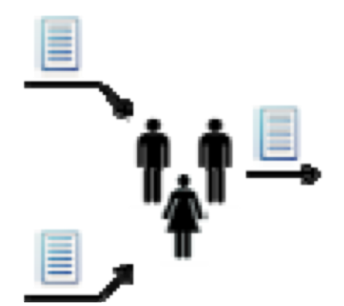
Decision tasks
Decision tasks solicit opinions about existing content
Example: choose between two descriptions of the same image
User input is constrained because the computer has to interpret the responses

Slide 21
Decision tasks
Goal of decision tasks is to solicit accurate responses
Solicit multiple responses and aggregate them
Mechanisms:
Comparisons: Is image description A better than image description B?
Ratings: Rate the quality of this description on a scale from 1-10.

Slide 22
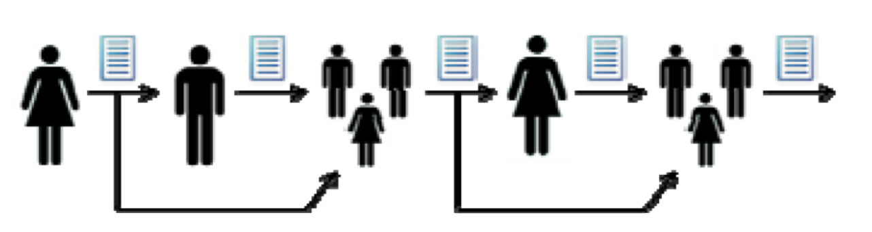
Pattern #1: Iterative combination
Workers are shown the content generated by previous workers
Computer optionally tracks the best content and either shows it or shows all previous content
Notes:
ccb - todo animate this figure

Slide 23
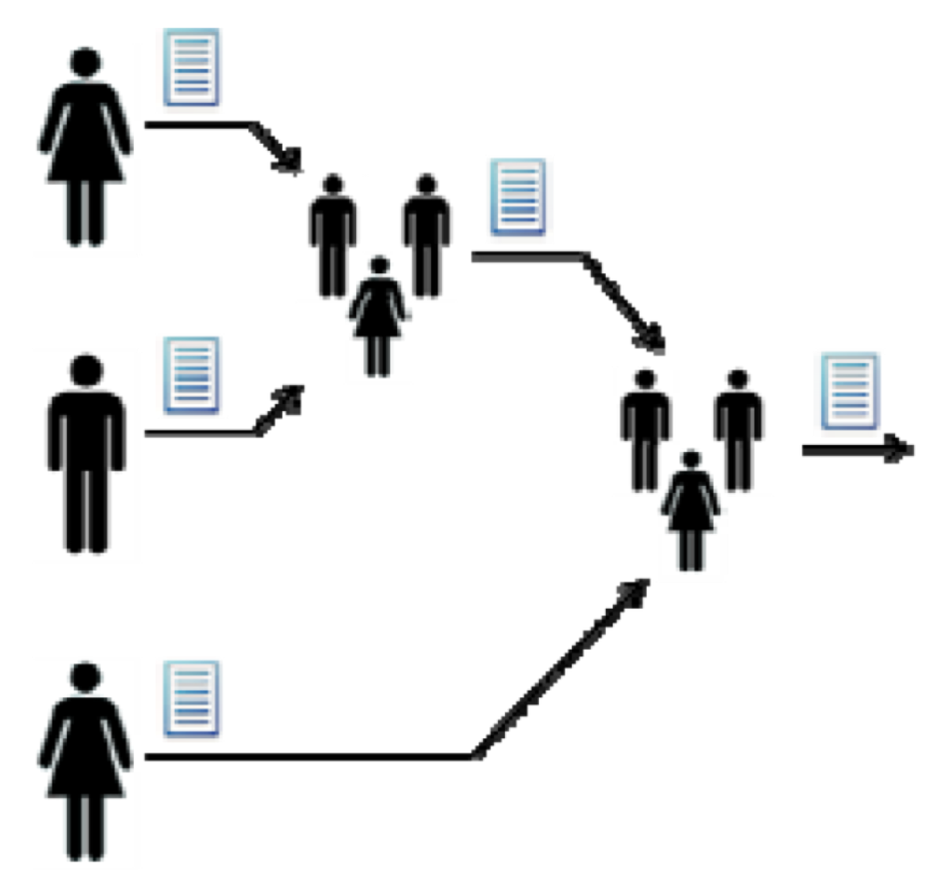
Pattern #2: Parallel creation
Creation tasks are executed in parallel
Workers do not see each others’ outputs
Outputs can be compared via decision tasks, as before
May be difficult to merge content

Slide 24
Experiments
Little, Chilton, Goldman, and Miller performed 3 experiments on MTurk to compare iterative vs parallel patterns:
1) Writing image descriptions
2) Brainstorming company names
3) Transcribing obscured texts

Slide 25
Experiment 1: Image description
Selected 30 engaging images from http://www.publicdomainpictures.net
Each image went through 6 creation tasks and 5 comparison tasks (with 5 people voting on the comparisons)
Ran on MTurk. Paid $0.02 for creation and $0.01 for comparison.

Slide 26
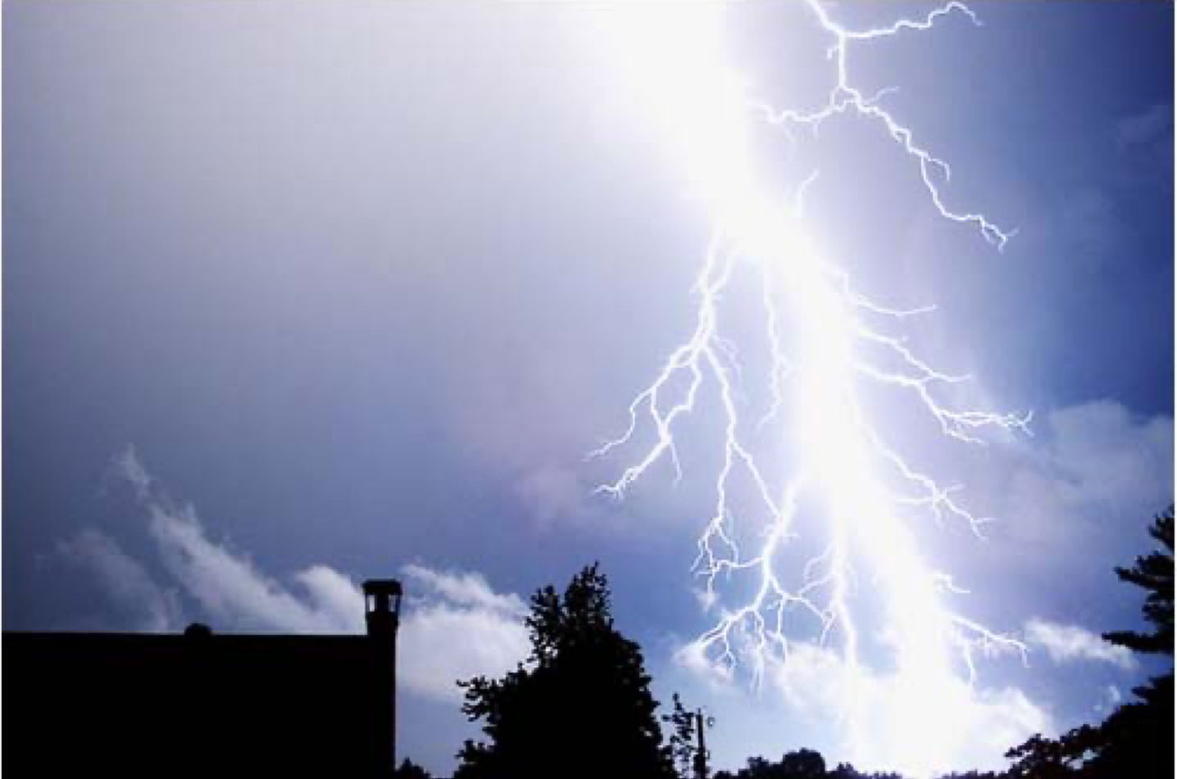
Please describe the text factually
(You may use the provided text as a starting point, or delete it and start over)
Use no more than 500 characters
Lightening strike in a blue sky near a tree and a building.

Slide 27
Iteration 1: Lightening strike in a blue sky near a tree and a building.
Iteration 2: The image depicts a strike of fork lightening, striking ablue sky over a silhoutted building and trees. (4/5 votes)
Iteration 3: The image depicts a strike of fork lightning, against a blue sky with a few white clouds over a silhouetted building and trees. (5/5 votes)
Iteration 4: The image depicts a strike of fork lightning, against a blue sky- wonderful capture of the nature. (1/5 votes)
Iteration 5: This image shows a large white strike of lightning coming down from a blue sky with the tops of the trees and rooftop peaking from the bottom. (3/5 votes)
Iteration 6: This image shows a large white strike of lightning coming down from a blue sky with the silhouettes of tops of the trees and rooftop peeking from the bottom. The sky is a dark blue and the lightening is a contrasting bright white. The lightening has many arms of electricity coming off of it. (4/5 votes)
Notes:
CCB - possibly show the iterative pipeline again

Slide 28
This image shows a large white strike of lightning coming down from a blue sky with the silhouettes of tops of the trees and rooftop peeking from the bottom. The sky is a dark blue and the lightening is a contrasting bright white. The lightening has many arms of electricity coming off of it.
Average Rating: 8.7
White lightning n a root-like formation shown against a slightly wispy clouded, blue sky, flashing from top to bottom. Bottom fifth of image shows silhouette of trees and a building.
Average Rating: 7.2
Notes:
Turkers were shown an image and a description, and asked to rate the quality of the description as a factual description of the image, on a scale of 1 to 10. We obtained 10 ratings for each image description to compute an average rating.
Averaged over all 30 images the Iterative wins at 7.9 versus 7.4. This is significant at p=0.004.

Slide 29
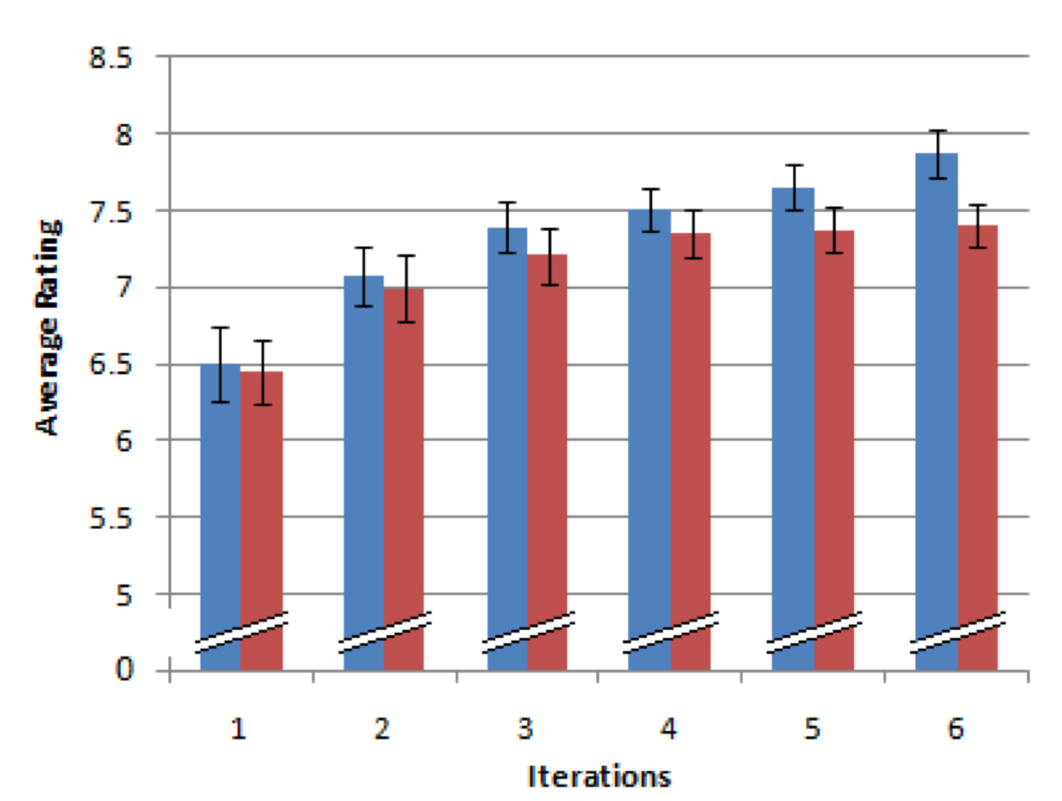
Relative improvements after each iteration
Iterative
Parallel
Notes:
Iteration 1 - they are the same, as you would expect.
The diverge as we increate the number of iterations.
Why?

Slide 30
What do Workers do at each iteration?
31% mainly append content at the end, make only minor modifications (if any) to existing content
27% modify/expand existing content, but it is evident that they use the provided description as a basis
17% seem to ignore the provided description entirely and start over
13% mostly trim or remove content
11% make very small changes (adding a word, fixing a misspelling)
Notes:
1% copy-paste random content from the internet

Slide 31
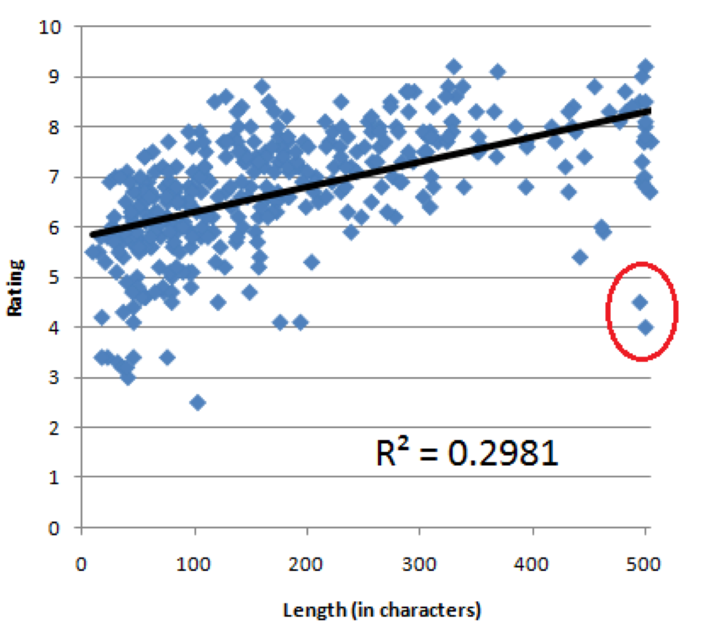
Correlation with description length and rating
Notes:
Figure 4: Descriptions are plotted according to their length
and rating. A linear regression shows a positive correlation (R2 = 0.2981, N = 360, 􏰃 = 0.005, p < 0.0001). The two circled outliers represent instances of text copied from the internet.

Slide 32
Experiment 2: Brainstorming names
Presented descriptions of 6 fictional companies
Asked Turkers to list 5 names each
Iteration had 6 tasks for each company, Turkers are shown the names so far
Parallel had 6 independent Turkers for each company

Slide 33
Brainstorming
Our company sells headphones. There are many types and styles available. They are useful in different circumstances. Our site helps users assess their needs, and get the pair of headphones that is right for them.
Please suggest 5 new company names for this company.

Slide 34
Example names
Iterative |  | Parallel
Easy on the Ears | 7.3 | music brain | 8.3
Easy Listening | 7.1 | Headphone House | 7.4
Music Explorer | 7.1 | Headshop | 7
Right Choice Headphone | 7.1 | Talkie | 6.8
... |  | ...
Least noisy hearer | 5.1 | company sell | 4.3
Headphony | 4.9 | head phones r us | 4.2
Shop Headphone | 4.8 | different circumstances | 3.7
Notes:
There are no bad ideas in brainstorming, but company sell and different circumstances are genuinely pretty terrible.
The best rated name generated in the iterative process is rated 7.3, compared with 8.3 for the parallel process. In fact, the parallel process generated the best rated name for 4 out of the 6 fake companies.

Slide 35
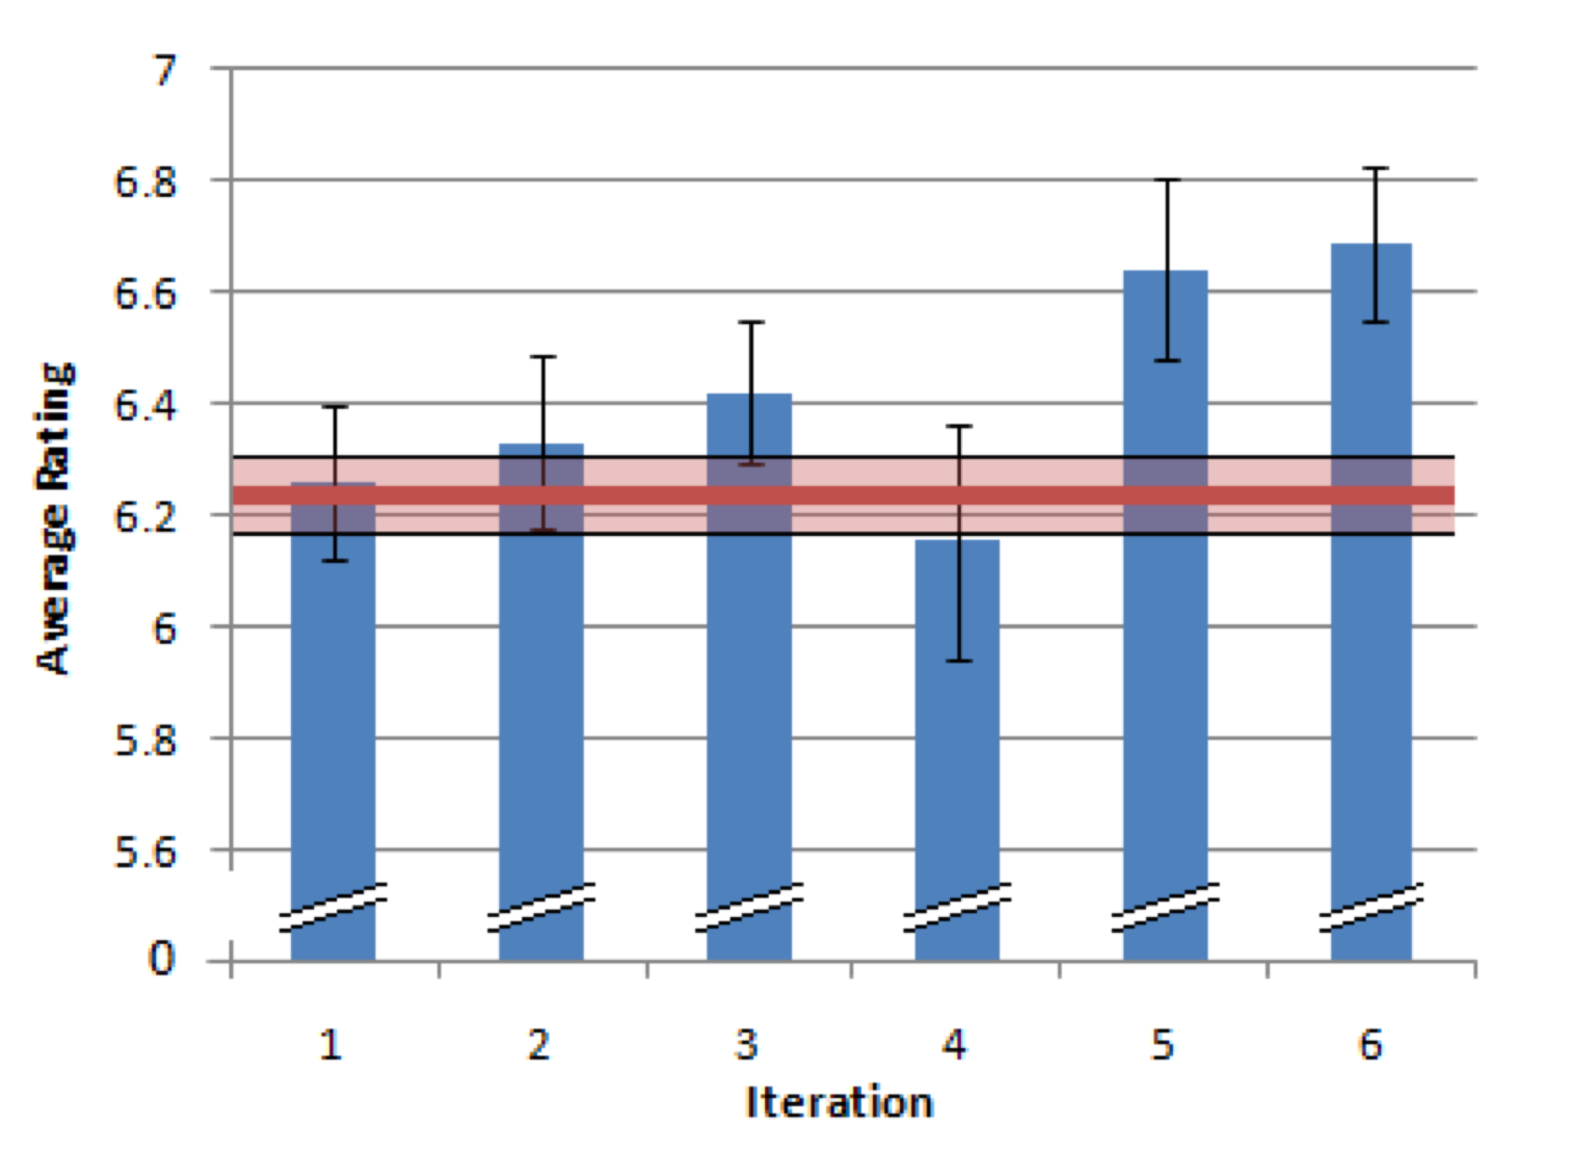
Iterative improvements
Iterative
Avg parallel
Notes:
The average name generated in the iterative process is rated higher (6.4 vs. 6.2).
Iteration four breaks the pattern, but this appears to be a coincidence. Three of the contributions in this iteration were considerably below average. Two of these contributions were made by the same turker (for different companies). A number of their suggestions appear to have been marked down for being grammatically awkward: “How to Work Computer”, and “Shop Headphone”. The other turker suggested names that could be considered offensive: “the galloping coed” and “stick a fork in me”.

Slide 36
Getting the best name
Iteration seems to increase the average rating of new names
Not clear that iteration is the right choice for generating the best rated names
Iterative process has a lower variance: 0.68 compared with 0.9 for the parallel process
Showing Turkers suggestions may cause them to riff on the best ideas they see, but makes them unlikely to think too far afield from those ideas
Notes:
Does showing people name suggestions inhibit their ability to generate the very best new name ideas?
If so, is there anything we can do in an iterative process that will help generate the best names?
Alternatively, is there any way we can increase the variance in the parallel process, to have an even better chance of generating the best names?

Slide 37
Experiment 3: Blurry text recognition
Human OCR, inspired by reCAPTCHA
“We considered other puzzle possibilities, but were concerned that they might be too fun”
16 creation task in both iterative and parallel processing

Slide 38
Blurry text transcription
Notes:
The instructions are simply to transcribe as many words as possible, and add a ‘*’ in front of words that they are unsure about.
We composed twelve original passages, so turkers couldn’t find the text on the web by searching with some of the keywords they had deciphered.
“blur” tool from some popular image editing program

Slide 39
Choosing the best result
If a particular word is guessed a plurality of times, then choose it
Otherwise pick at random from the words that tied for best

Slide 40
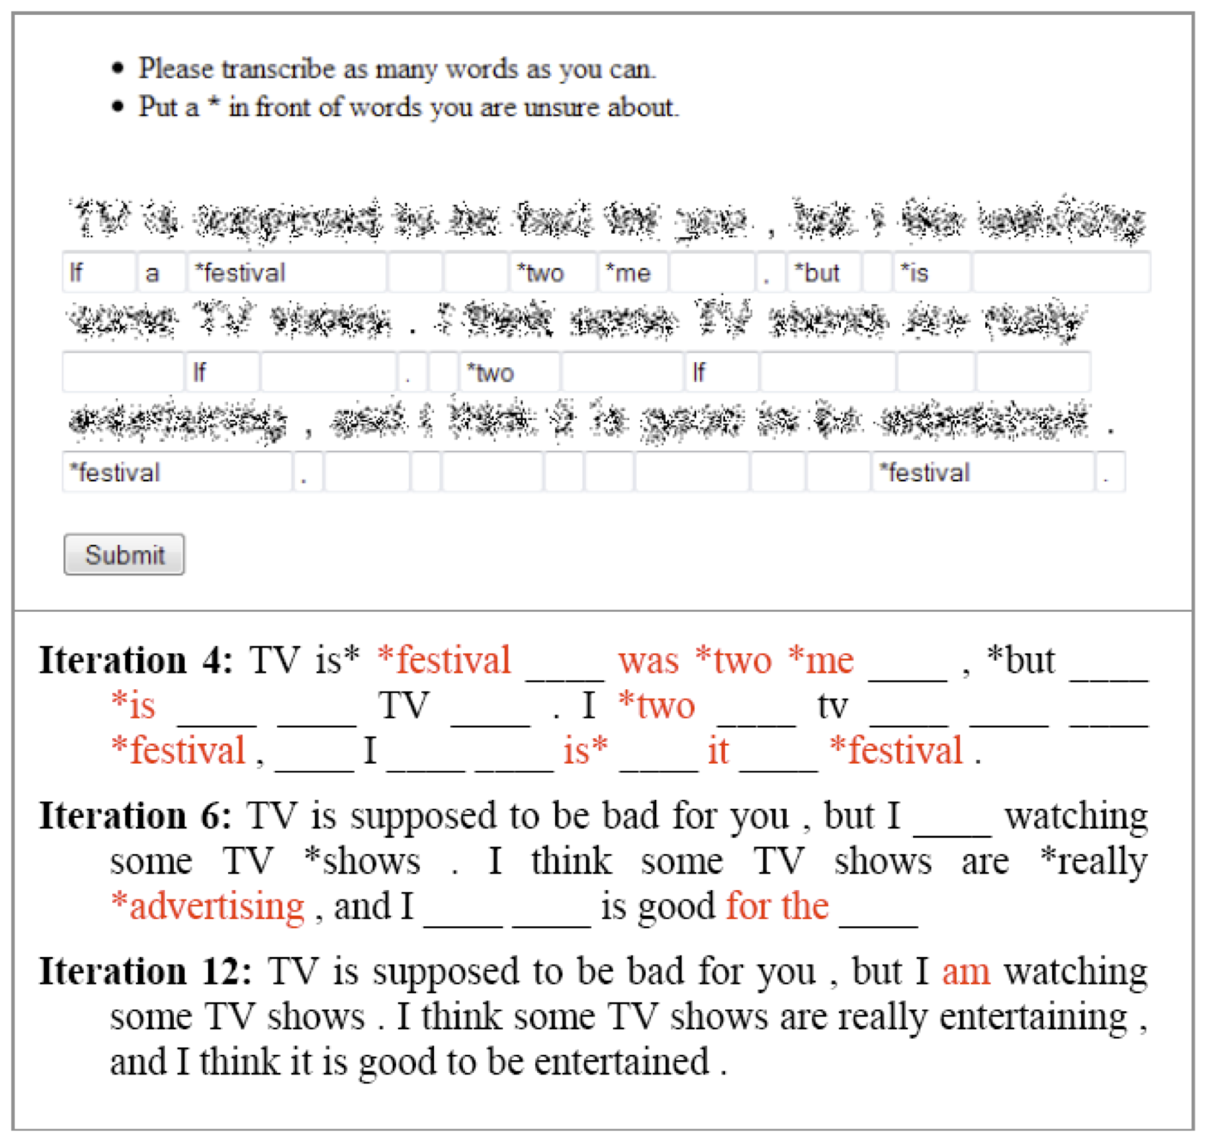

Slide 41
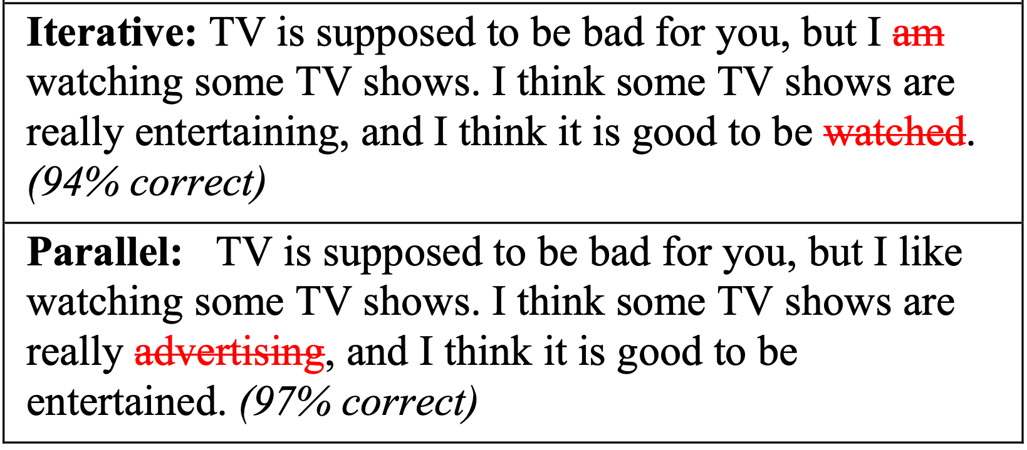

Slide 42
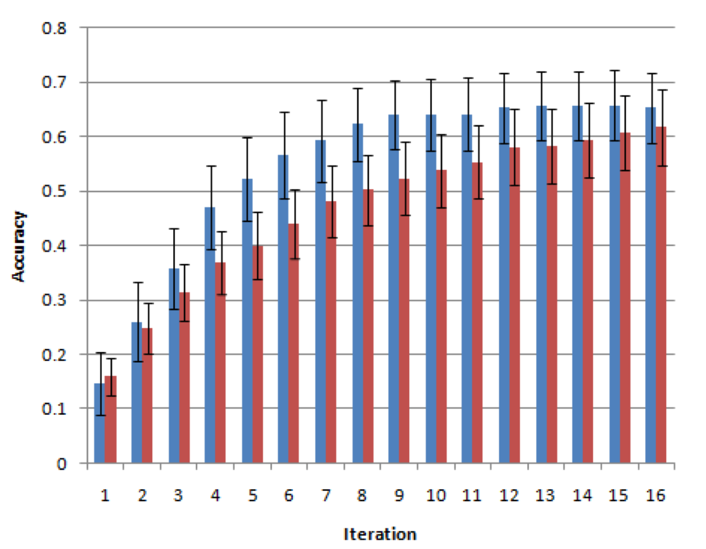
Accuracy after several iterations
Iterative
Parallel
Notes:
The overlap suggests that the processes may not be different, or that there were not enough samples in their experiment to see a statistically significant difference.

Slide 43
Sometimes poor initial guesses cause problems
8th iteration: “Please do ask *anything you need *me. Everything is going fine, there * * , show me then * * anything you desire.”
16th iteration: “Please do ask *about anything you need *me. Everything is going fine, there *were * , show me then *bring * anything you desire.”
Several of the workers doing the task in the parallel condition got it 100% correct
Notes:
One Turker left this comment. “It's distracting with the words filled in--it's hard to see anything else but the words already there, so I don't feel I can really give a good “guess” ”.

Slide 44
Discussion
What do these results tell us about iterative versus parallel processing in human computation?
Are the experiments well formulated?
Is James Surowiecki right?

Slide 45
Tradeoff between average and best
The brainstorming task showed tradeoff between increasing the average quality vs increasing the chance of finding the best
Showing previous work increased quality, but decreased variance

Slide 46
Leading people astray
The blurry text task showed that initially bad guesses can lead to poorer quality later
Suggests that a hybrid approach may be better: start multiple iterative jobs in parallel

Slide 47
Conclusions
Experimentally, iteration seems to increase the average quality of responses over parallel processing
However, brainstorming and transcription benefit from a variety of responses
Poor guesses in the transcription task can lead subsequent workers astray
Notes:
Statistically significant in writing and brainstorming.

Slide 48
Future Work

Slide 49
Recap: Model
 | dependently (iteratively) | independently (in parallel)
creation tasks
decision tasks
Notes:
Task type and how it is done

Slide 50
What factors affect Creation Tasks?
How much does the reward affect quality?
How much work is expected? Is it better to break the task down into smaller pieces?
Are examples shown? Is prior work shown?

Slide 51
What factors affect Decision Tasks?
Goal is to determine the best items in a set
What’s the best way to achieve this?
Absolute ratings?
Pair-wise comparisons?
Sorting multiple items in a single task?

Slide 52
New building blocks
What other building blocks exist?
What paradigms and metaphors should we use to think about human computation?

